Slide 1


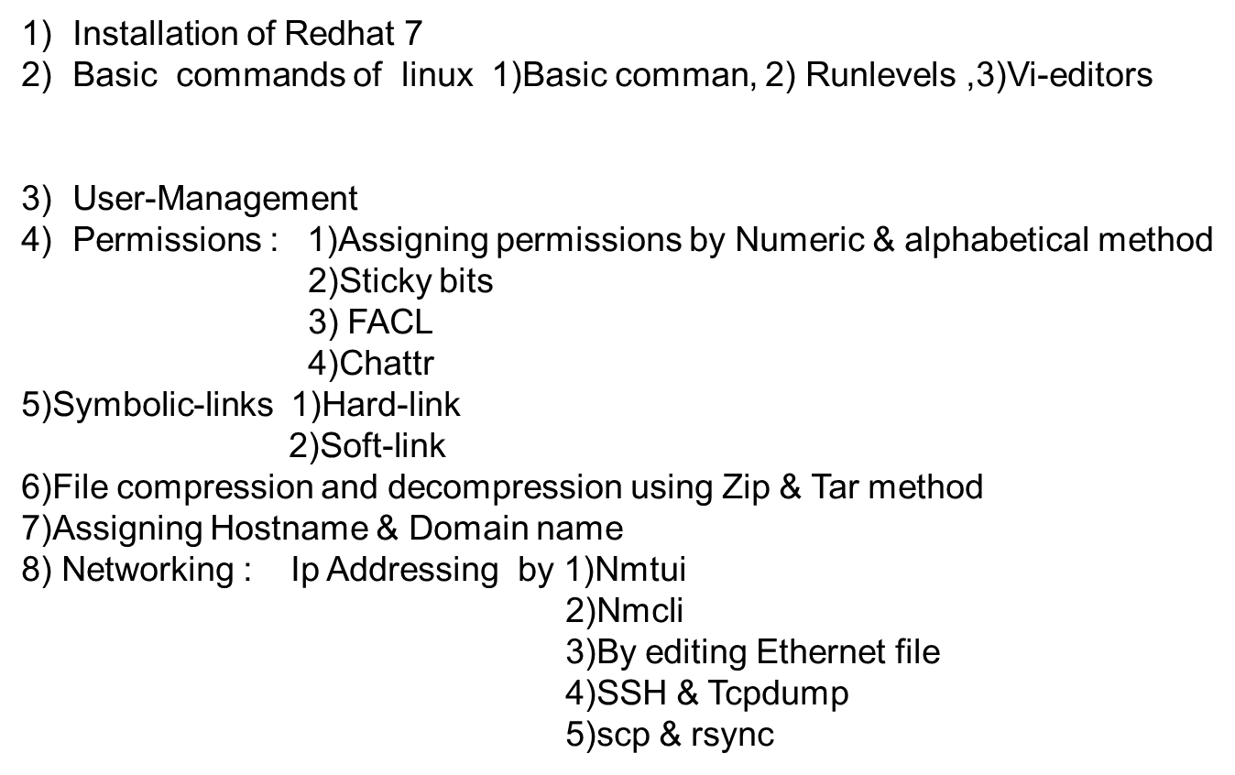

Slide 2


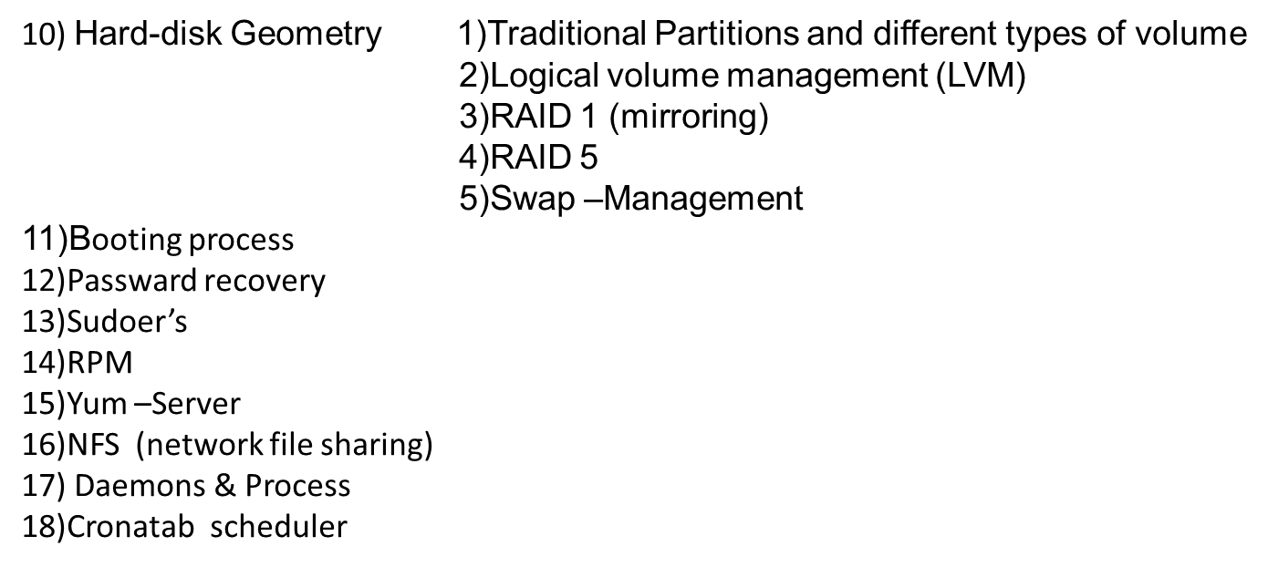
19)Firewall in Linux

Slide 4
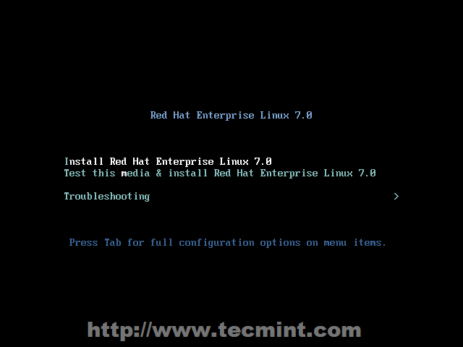
Redhat 7.0 Installation Process
Rdhat 7.0 Installation Process
Place your DVD/USB into your system, press [Enter] key

Slide 5
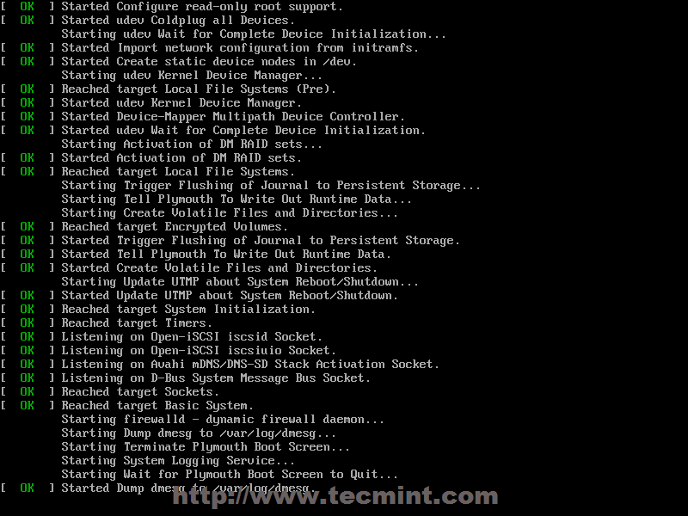
Installation step-2
The system will start loading media installer and a Welcome screen should appear. Select your Installation Process Language, that will assist you through the entire installation procedure and click on Continue.

Slide 6
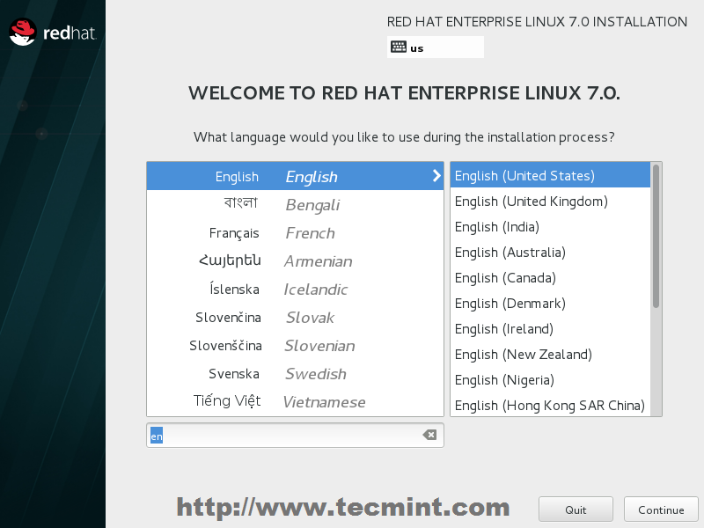
Installation step-3

Slide 7
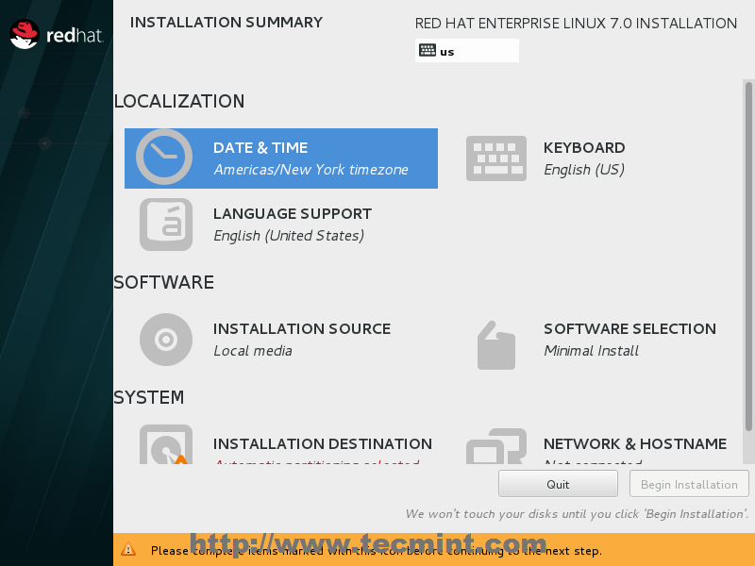
Installation step-4
When the installer gets on Installation Summary it’s time to customize the installation process. First click on Date & Time, choose your system location from the provided map and hit on Done to apply configuration.

Slide 8

Installtion step-5

Slide 9
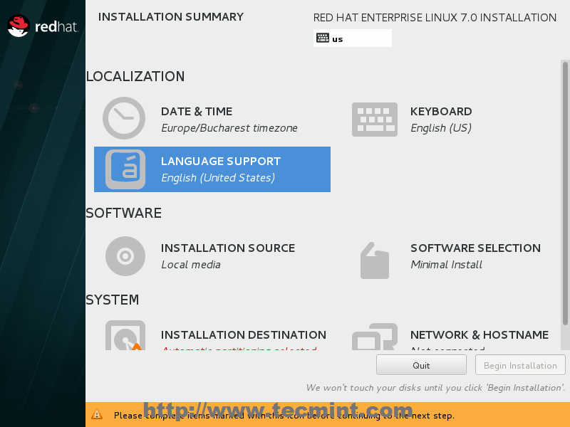
Installation step=6
The next step is to change Language System Support and Keyboard language. Click on both if you want to change or add other languages to your system but for a server the recommendation is to stick with English language.

Slide 10
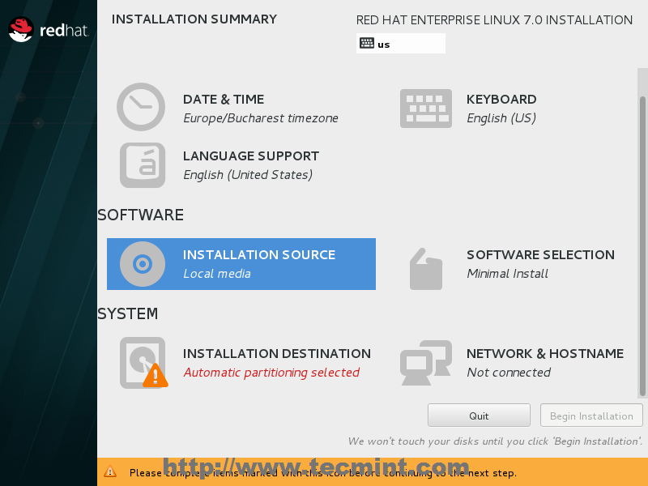
Installation step-7
Set default one Auto-detected installation media.

Slide 11
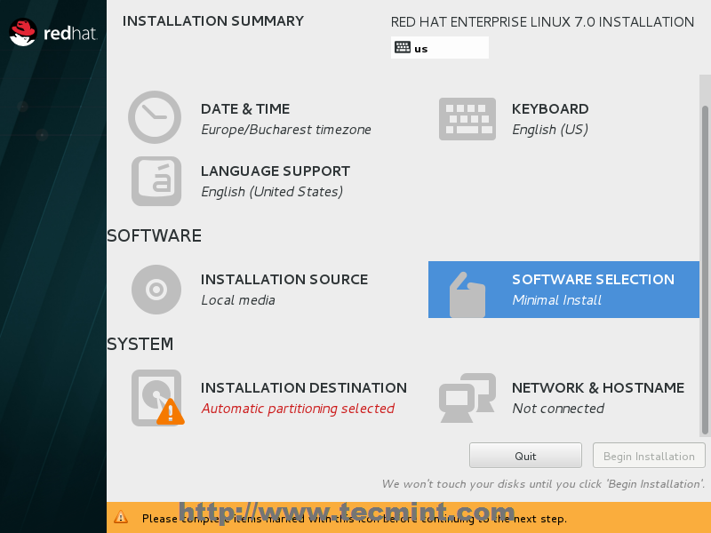
Installation step=8
The next important step is to select your system software. Click on Software Selection and choose your Base Installation Environment from the down-list. If you select minimal you will have command line screen but if you want to work on command line as well as graphic then select server with GUI, here we select minimal

Slide 12
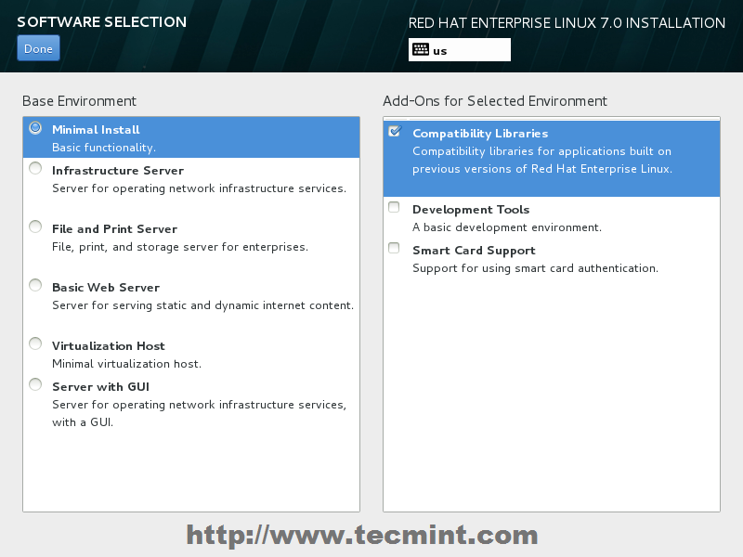
Installation step =9

Slide 13
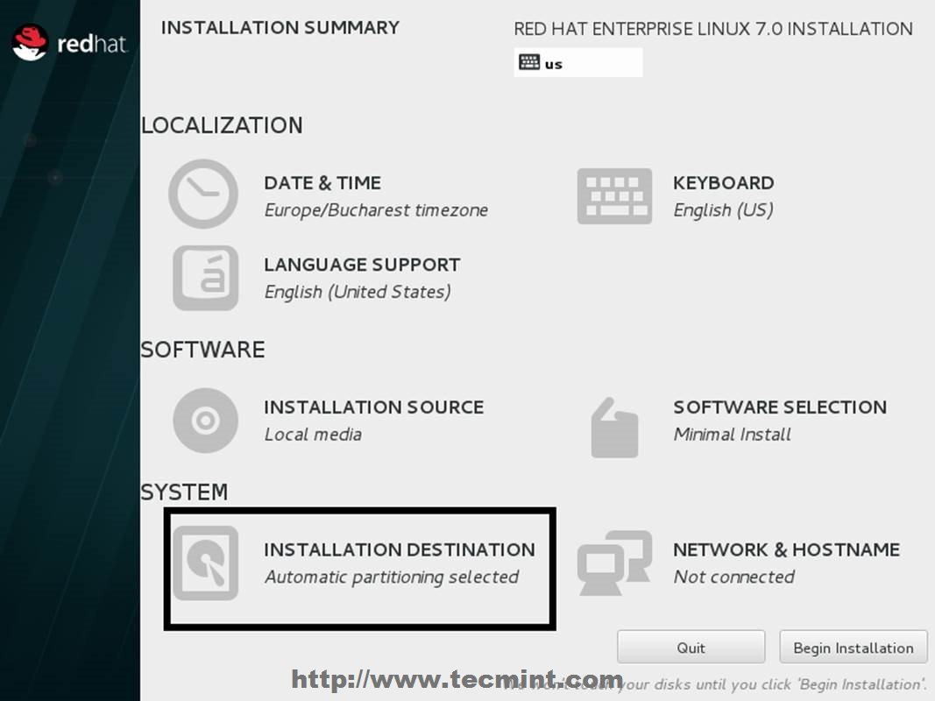
Installation step 10
The next important step is to configure your system partitions. better management over system space, then hit on Click here to create them automatically.

Slide 14
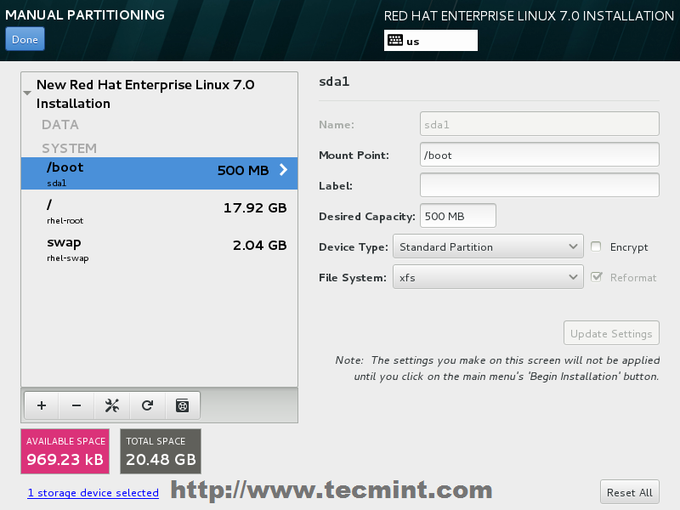
Installation step=11
We create this partition by selecting standard partion option

Slide 15
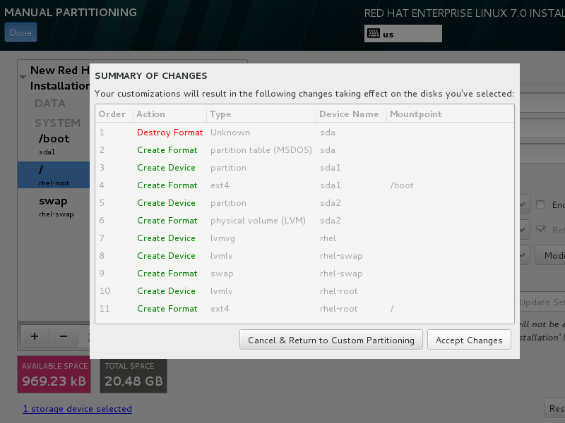
Installation step12
Here we select option Accept changes

Slide 16
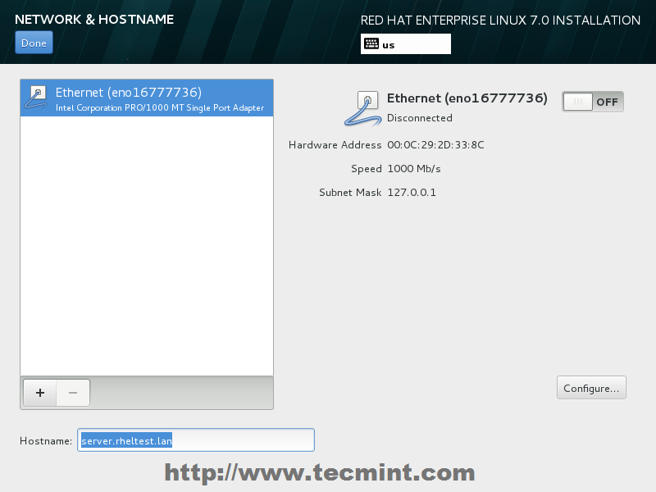
Installation step=13
he last step before continuing with installation process is setting your Network Connection. Click on Network & Hostname and setup your system hostname

Slide 17
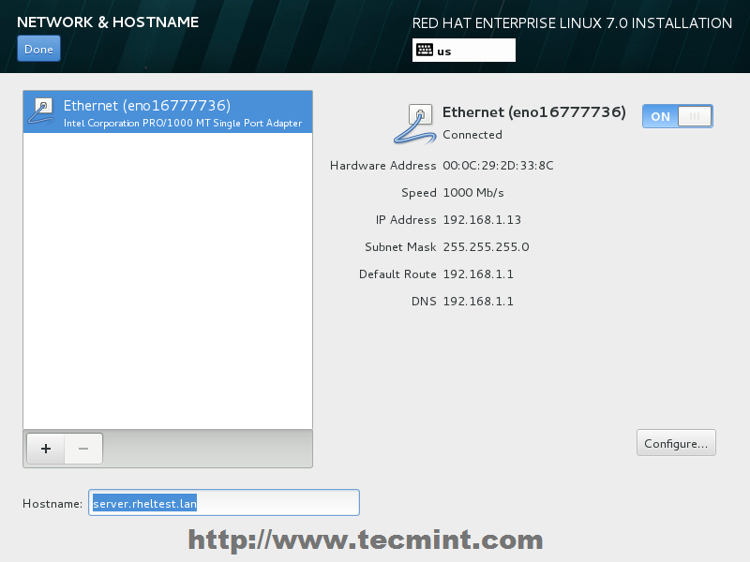
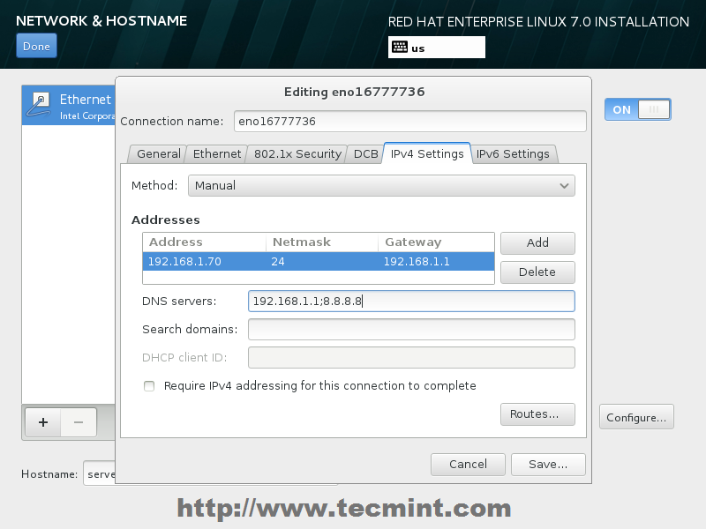
Installation step =14
After setting up hostname bring up your Network Interface by switching the top Ethernet button to ON. If your network provides automatic Interface configurations through a DHCP server your IPs should be visible on Ethernet Interface Card else go to Configure button and provide your static network settings for your appropriate network connection.

Slide 18
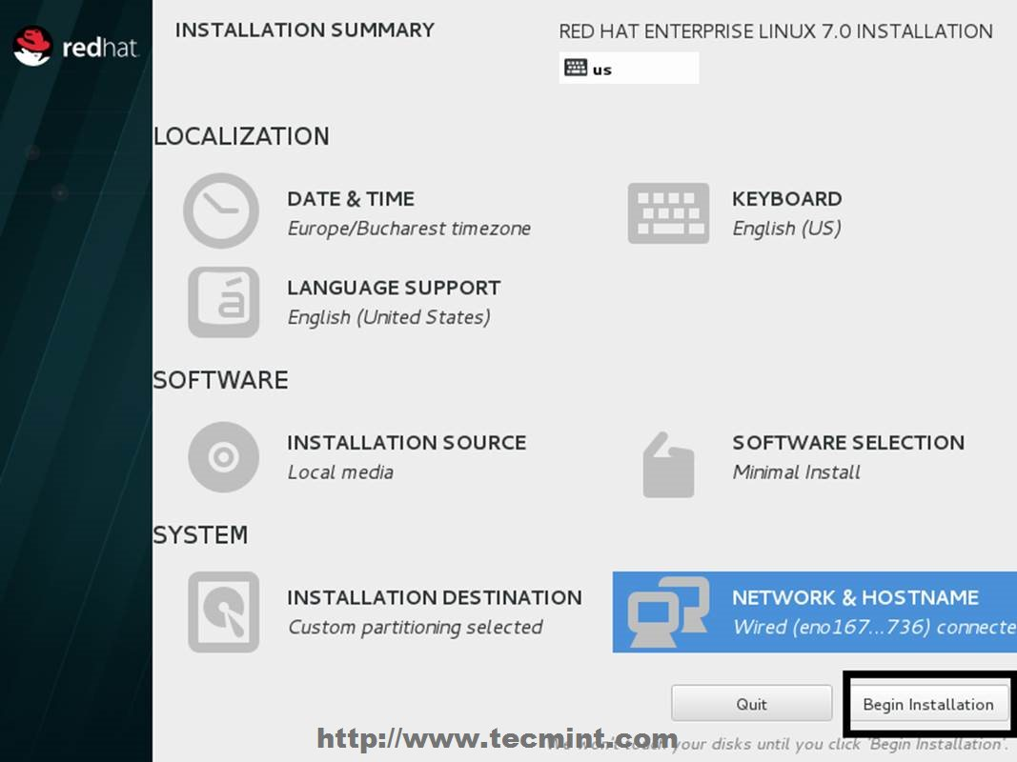
Installation step=15
After finishing editing Ethernet Interface settings hit on Done which you bring you to default window installer and after you check on your installation settings hit on Begin Installation to proceed further with system installation.

Slide 19
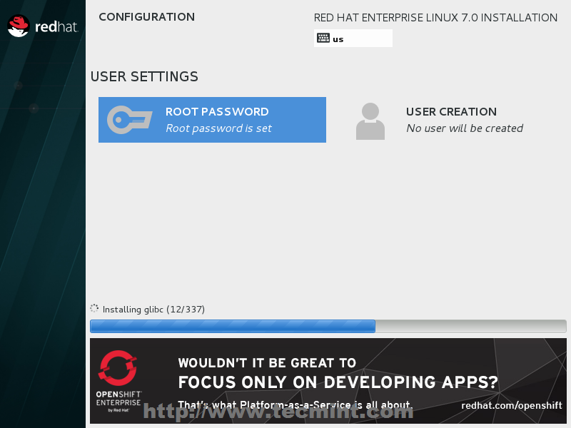
Installation step=16
As the installation begins writing the system components on your hard-disk, you need to supply your Root Password and create a new User. Click on Root Password and try choose a strong with one at least eight characters in length (alpha-numerical and special characters) and hit in Done when you finish.

Slide 20
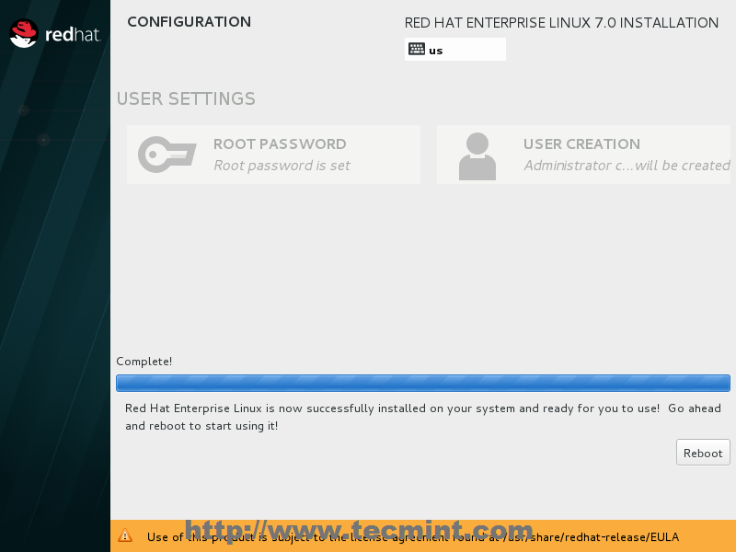
Installation step=17
After the installation finishes the installer will announce that everything completed with success so you should be ready to use your system after reboot.

Slide 21




Linux is an operating system or a kernel. It is distributed under an open source license Open source meaning an operating system of which we can see the source code and can modify it as per our requirement . Its functionality list is quite like UNIX
Linux is an operating system or a kernel which invented by young and bright Linus Torvalds when he was a computer science student. He used to work on the UNIX OS .

Slide 22
Introduction of linux-1
Introduction of linux-1
The benefits of using Linux
Being open-source, anyone with programming knowledge can modify it.
The Linux operating systems now offer millions of programs/applications to choose from, most of them free!
Once you have Linux installed you no longer need an antivirus! Linux is a highly secure system. More so, there is a global development community constantly looking at ways to enhance its security. With each upgrade, the OS becomes more secure and robust
Linux is the OS of choice for Server environments due to its stability and reliability (Mega-companies like Amazon, Facebook, and Google use Linux for their Servers). A Linux based server could run non-stop without a reboot for years on end.

Slide 23
Introduction of linux-1
Introduction of linux-1
The benefits of using Linux
Being open-source, anyone with programming knowledge can modify it.
The Linux operating systems now offer millions of programs/applications to choose from, most of them free!
Once you have Linux installed you no longer need an antivirus! Linux is a highly secure system. More so, there is a global development community constantly looking at ways to enhance its security. With each upgrade, the OS becomes more secure and robust
Linux is the OS of choice for Server environments due to its stability and reliability (Mega-companies like Amazon, Facebook, and Google use Linux for their Servers). A Linux based server could run non-stop without a reboot for years on end.
A Linux distribution (often abbreviated as distro) is an operating system made from a software collection that is based upon the Linux kernel
1)Redhat 5)Linux Mint
2)Centos 6)Suse linux Enterprise/ Open suse
3)Ubantu 7)Mandriva
4)Debian 8)Arch linux

Slide 24
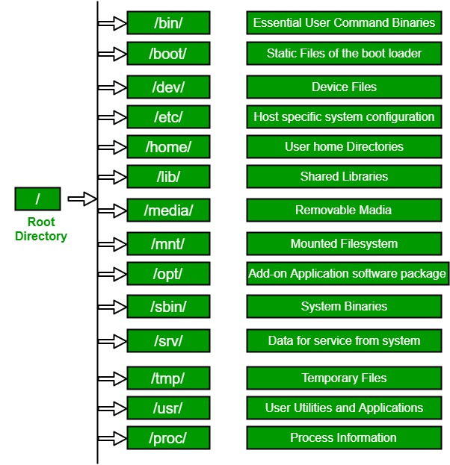
Linux File Hierarchy Structure
Linux File Hierarchy Structure
The Linux File Hierarchy Structure or the Filesystem Hierarchy Standard (FHS) defines the directory structure and directory contents
In the FHS, all files and directories appear under the root directory /

Slide 25
Basic commands
Basic commands
(Root@linux1 ~)#
(Tom@linux1~)$
Login username
Login username
Hostname
Hostname
UserLocation
UserLocation
Login in Superuser
We are logged in standered user

Slide 26
Basic commands:
$df -h -> same as my computer in windows
$fdsik -l -> list partition
$man <cmd> -> manual
$clear -> clear the screen
$^l -> clear the screen
$ls -> list content
$ls -l -> list content in long listing format
$ls -al -> list all subcontent in long listing format
$ll -> an alias for the above
$ls -R -> list content recursively
$l. -> list hidden files
$ls -F -> list content and classify them
$alias -> display all aliases for current user
$exit -> log out from the system
$logout -> log out from the system
$^d -> log out from the system
$tree -> list content in a tree (hierarchial) diagram
$tree -d -> list subdirectories only - no files
$tree -p -> list content with their permissions
$cd <directory> -> change directory to...
$cd .. -> change to parent directory
$cd - -> change to previous directory
$cd -> change to home directory
$cd ~ -> change to home directory

Slide 27
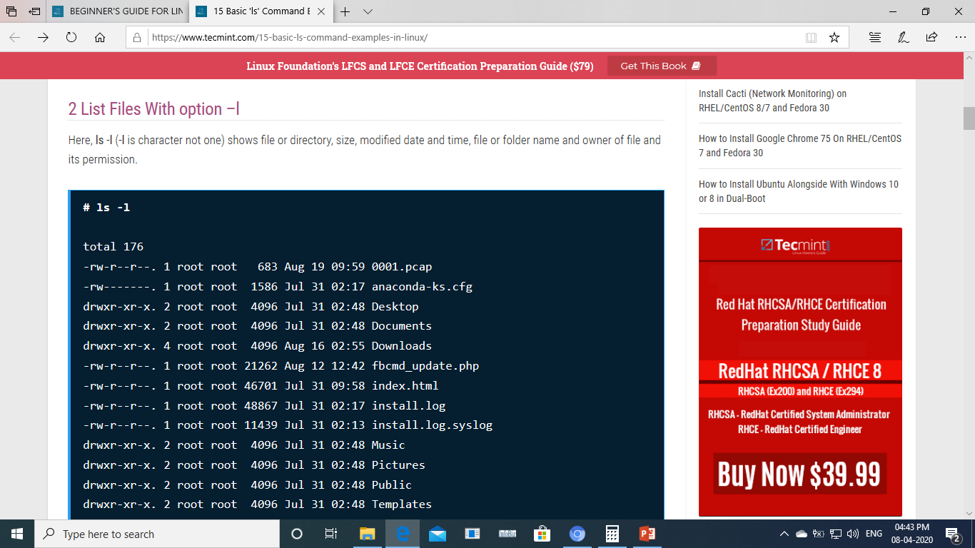
#ls -l command

Slide 28
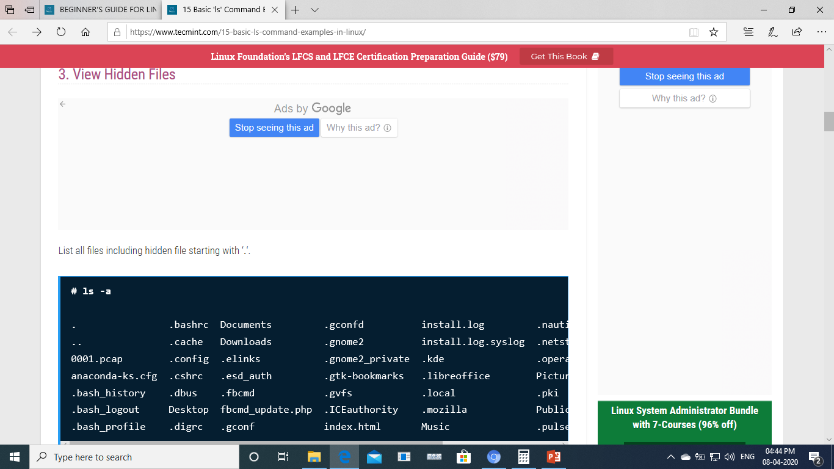
#ls –a to see hiden files of current location

Slide 29
Basic commands
Basic commands
$cat -> display a content of a file
$pwd -> print work (current) directory
$pwd -P -> print parent working dir of this symlink dir
$mkdir <directory> -> make directory
$mkdir -p <directory> -> make parent directories also if it does not exist
$touch -> make a 0 byte file if it does not exist
$cp -> copy (for files)
$cp -a -> copy (for directories)
$cp -p -> copy and preserve date and time
$mv -> move OR rename
$rmdir -> remove empty directory
$rm -> remove (for files)
$rm -f -> remove forcefully ( " " )
$rm -r -> remove recursively (for directories)
$rm -rf -> remove recursively and forcefully ( " " )
$cat -> display content of the file
$cal -> display calendar for current month
$date -> display system date and time
$date -s '<value>' -> change system date and time in mm/dd/yy
$hwclock -> display the hardware clock
$hwclock –hctosys -> set the system time from the hardware clock

Slide 30


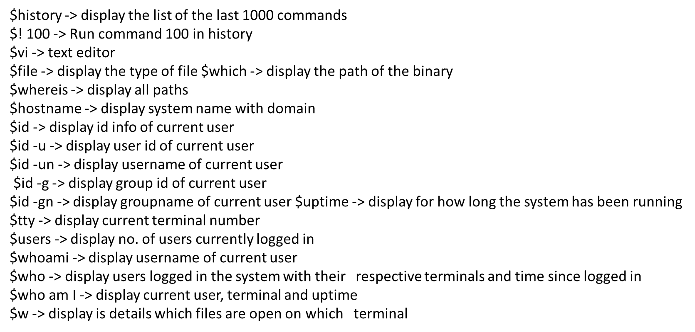

Slide 31
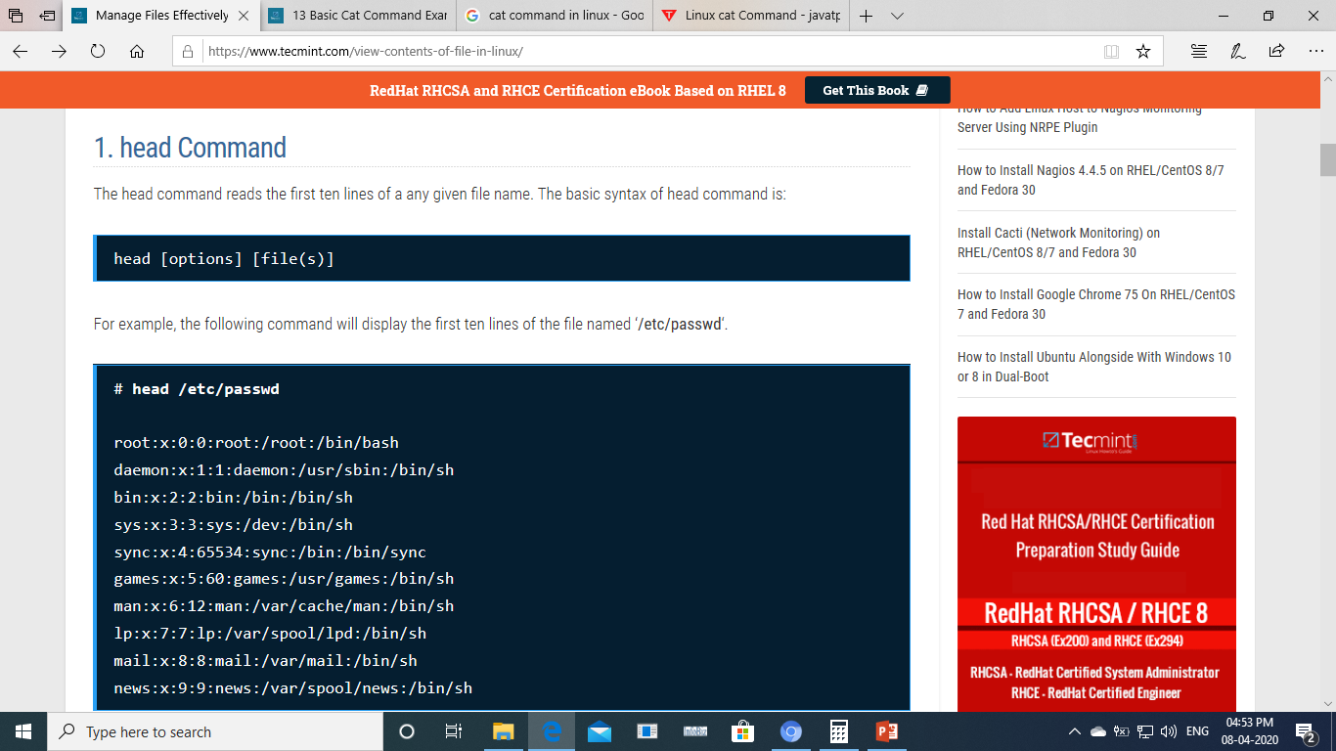
Head command
For example, the following command will display the first ten lines of the file named ‘/etc/passwd
We cam write it as # head -10 /etc/passwd

Slide 32
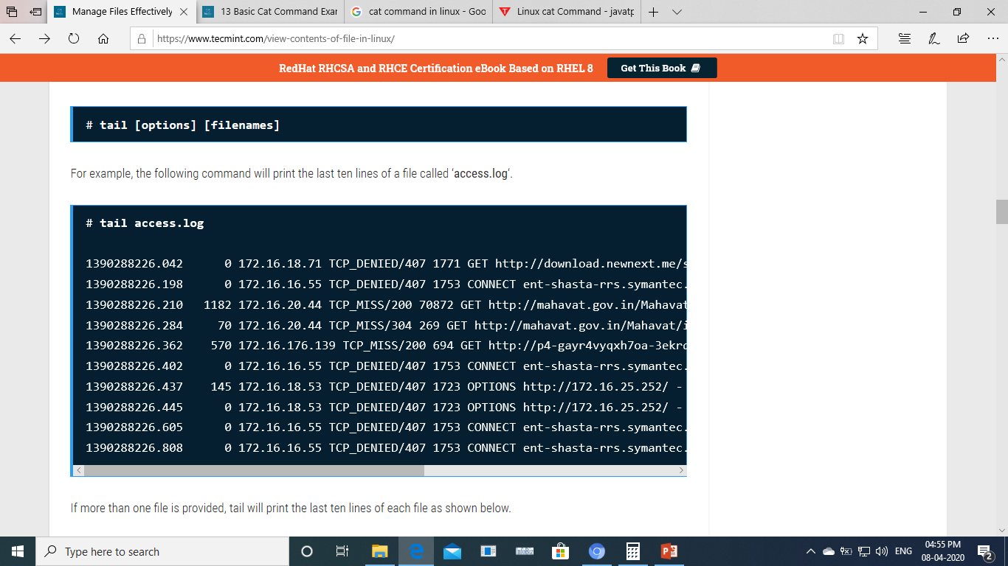
Tail command
The tail command allows you to display last ten lines of any text file
# tail -10 /etc/passwd

Slide 33
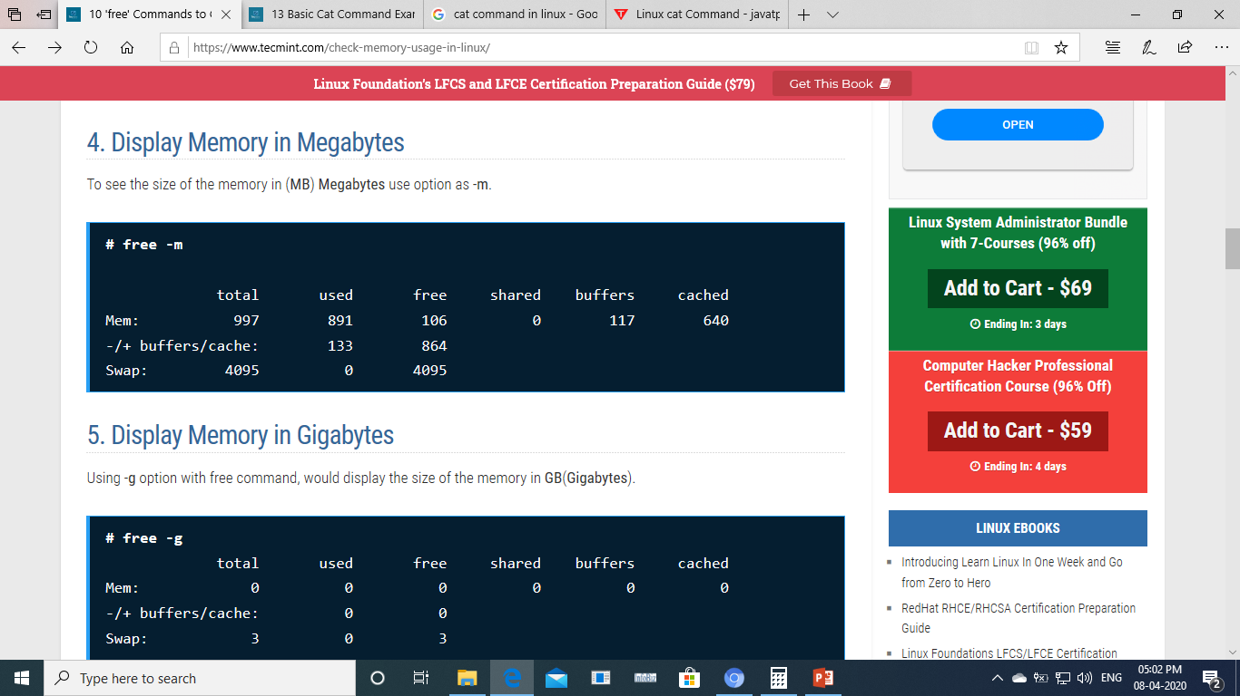
To see size of memory

Slide 34


Shortcuts
Cursor Movements IN the file
H - to move the cursor to the left
J - to move the cursor to down
K - to move the cursor to up
L - to move the cursor to right
$ -cursor will go to end of the line
0 - cursor will come to the start of the line
W - will move the cursor word by word towards right
B - will move the cursor word by word towards left
Shift+H - will take the cursor to the beginning of the file to the start of the line
Shift +L - will take the cursor to the beginning of the file to the end of the line
gg - will move the cursor at the first line of the file
shift+g - will move the cursor at the last line of the file
:se nu - will show the serial no
:<line no (5)> - will take the cursor to the specified line
5+shift+G - will take the cursor to the specified line no

Slide 35

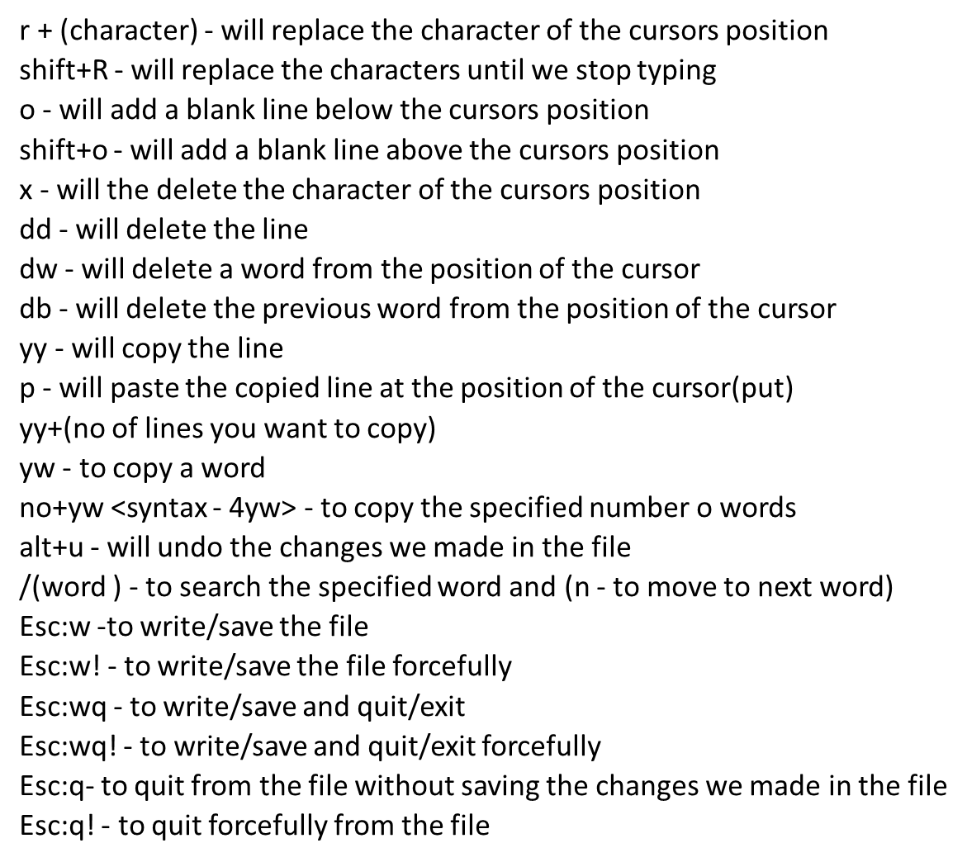

Slide 36


Only root (i.e. system administrator)can use adduser command to create new users. It is not allow to other users.
Adduser is symlink of Useradd which is binary in /usr/sbin. We(root)can customise adduser by using another word(champu) & make it symlink of useradd. Let's see
[root@localhost root]# cd /usr/sbin
There are 3 types of users
<1> Superuser : At the time of linux installation it is create. He has right to make other users & his`userid'& `groupid' is zero in `/etc/Passwd' file.
<2> Systemuser: These users create by System. They can't login becoz their shell `sbin/noloin' is default in seventh field in `/etc/passwd' file.
<3> Normaluser: These users create by superuser.

Slide 37


Let's see how superuser make normaluser :
[root@localhost root]# adduser john
[root@localhost root]#passwd john Changing password for user john.
New password:(user password) BAD PASSWORD: it is too short (if password is less than six character but it doesn't affect so no need to worry)
Retype new password:(user password) Passwd: all authentication tokens updated succesfully.
[root@localhost root]#userdel john ---> `userdel' command delete only name of the user from /home directory but it's data remain there. It's /usr/sbin/userdel
[root@localhost root]# userdel -r john ---->userdel -r delete name of user as well as data.
[root@localhost root]# usermod -G groupname username

Slide 38
[root@localhost root]# usermod -G john eric
---->`usermod -G' command makes the user eric member of the group john. /usr/sbin/usermod. su ----> with the help of this command root can work as substitute user.
su -r ---->with the help of this command root come out from subtitute user.
The information of adduser refers 2 files & updates 3files.
useradd Updates
|---/etc/passwd |
|----/etc/group |
|----/etc/shadow |

Slide 39


/etc/passwd
champu:x:1000:1000::/home/champu:/bin/bash \____/\_/\__/\_/||\___________/\______/ | | | | || | | 1 2 3 4 5 6 7
field (champu) : It is username
2. field (x) : It contain user password which is somewhere else if exist. If we put * inplace of x then user can't login. If we keep second field blank then user can login without password. i.e. (x) --- password somewhere else. (*) --- user can't login. ( ) --- user can login without passwd.
3. field (1000) : It contain userid which is unique. Further userid's are just one greater than last user.
4. field (1000) : It contain groupid which is always same as userid. It's group of users.
5. field () : It is comment field or GECOS(General electric compressive operating system) user can keep his information by using command `chfn'in this field such as $ chfn Name []: office []: office phone []: Home phone []:
6. field (/home/champu) : It's home of champu. /home is directory where all users store.
7. field (/bin/bash) : It contain the full path of shell used by user. Through shell we can convert shell script into binary format & whatever get from kernal convert into text format.

Slide 40

/etc/group
/etc/group : This file keep the information of group. It has four field of each group of each line so it is called `system group database'. Member of group has right to enter other member's of system who is member of same group.
line in this field like follow
Accounts:x:1000
1. field (accounts) : It contain name of group which is always same as the first member username. 2. field (x) : It contain group password which is somewhere else if exist & it's password is same of first member of group. 3. field (1000) : It contain group id which is same of first member's id of group. 4. field : It contains list of members of group. By default Redhat it is blank but user can fill it by put the name of members of group.
One user can makes members of his group by using command `usermod -G' which is run by only root. #usermod -G groupname username when system admin first time creates users he can send message like `Thanku for using redhat linux' through this & user get this mail whenever he login.

Slide 41


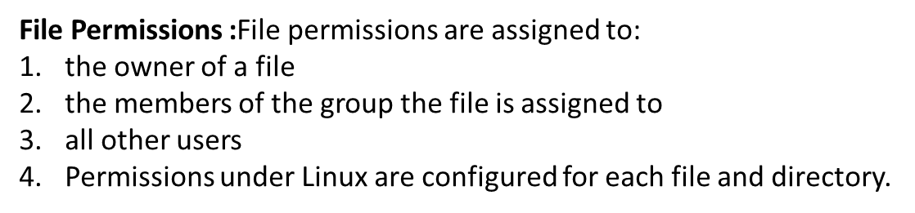

Read allow the user to read the contents of the file, for instance with cat or less.
Write allow the user to modify the contents of the file,for instance with vi.
Execute allow the user to execute the file as a program, provided that the file is indeed an executable program (such as a shell script).
Read : allow the user to view the contents of the directory, for instance with ls.
Write :allow the user to modify the contents of the directory. In other words: allow the user to create and delete files, and to modify the names of the files. Note: Having write permissions on a directory thus allows you to delete files, even if you have no write permissions on that file!
Execute: allow the user to use this directory as its current working directory. In other words: allow the user to cd into it.

Slide 42

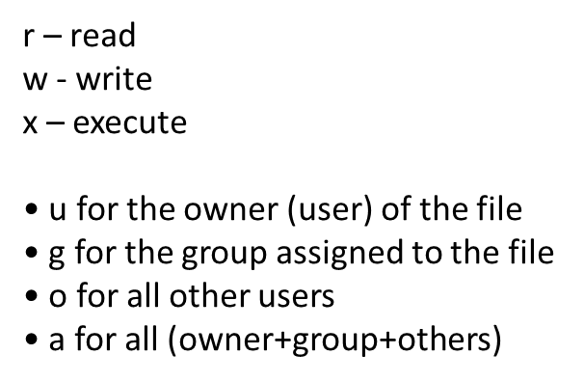
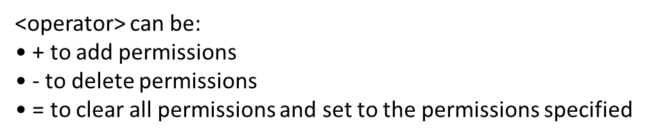

Slide 43
Symbolic or alphabetic way
$ useradd sachin
$ passwd Sachin
$ useradd dhoni
$ passwd dhoni
$ groupadd market;usermod –G market dhoni
$ useradd shewag
$ passwd shewag
$ groupadd market;
$usermod –G market shewag
$ mkdir /opt/perm/{data1,data2}
$ cd /opt/perm
$ ll –d data1 drwxr-xr-x 2 root root 4096 Jul 29 20:15 data1
$ chown sachin data1
$ ll –d data1
$ chgrp market data1
$ ll –d data1
$ chmod u-w data1
$ ll –d data1
$ chmod g+w data1
$ ll –d data1
$ chmod o+w,o-rx data1
$ ll –d data1
$ ll –d data2 drwxr-xr-x 2 root root 4096 Jul 29 20:15 data2
$ chown –Rv sachin.market data
$ ll –d data2
$ chmod u-rwx data2
$ ll –d data2
$ chmod g+w,g-x data2
$ ll –d data2
$ chmod –Rv o+w,o-r data2
$ ll –d data2
Numeric way
$ ll file1 -rw-r--r—- 1 root root 0 Jul 29 20:15 file1
$ chmod 777 file1
$ ll file1
$ chmod 666 file1
$ ll file1
$ chmod 467 file1
$ ll file1
$ chmod 541 file1
$ ll file1
$ chmod 724 file1
$ ll file1
$ chmod 000 file1
$ chmod 0 file1

Slide 44


A Sticky bit is a permission bit that is set on a file or a directory that lets only the owner of the file/directory or the root user to delete or rename the file. No other user is given privileges to delete the file created by some other user.
Values use to set sticky bits
Owner =4
Group =2
Others=1

Slide 45



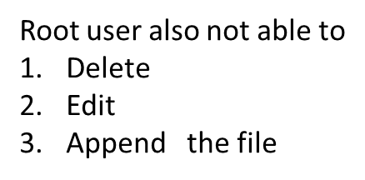
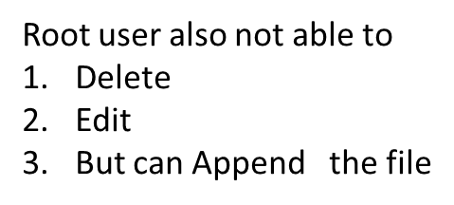


Append
#chattr +a filename

Slide 46


Symlinks & Hardlinks
Files are arranged in directories (or folders if you prefer that term), and each file can be reached through a series of directories and subdirectories from the root - correct? Yes ... BUT ... there are some times that the same file can be reached through several names, and on Unix and Linux systems this is known as a "link". There are two ways a link can be set up.
Hard Link
A Hard Link is where a file has two names which are both on an equal weighting, and both of the file names in the "inode table" point directly to the blocks on the disc that contain the data. See diagram to the left.
You set up a hard link with an ln command without options - if the file ab.txt already exists and you want to give an additional name (hard link) to it, you'll write ln ab.txt cd.txt and then both names will have equal ranking. The only way you'll know that there's a link there is by doing a long listing and you'll see a link count of 2 rather than 1, and if you need to find out what's linked to what, use the -i option to ls.
Symbolic Link A Symbolic Link is where a file has one main name, but there's an extra entry in the file name table that refers any accesses back to the main name. This is slighly slower at runtime that a hard link, but it's more flexible and much more often used in day to day admin work.
Symbolic links are set up using the ln command with the -s option - so for example ln -s ab.txt cd.txt will set up a new name cd.txt that points to the (existing) file ab.txt. If you do a log listing (ls -l) of a directory that contains a symbolic link, you'll be told that it's a symbolic link with an "l" in the first column, and you'll be told where the file links to in the file name column.

Slide 47



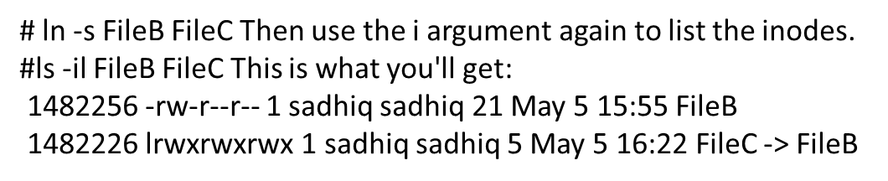
you made a file called FileA
We'll creat the hardlink FileB
# ln FileA FileB
This is what you get:
1482256 -rw-r--r-- 2 sadhiq sadhiq 21 May 5 15:55 FileA
1482256 -rw-r--r-- 2 sadhiq sadhiq 21 May 5 15:55 FileB
You can see that both FileA and FileB have the same inode number (1482256). Also both files have the same file permissions and the same size. Because that size is reported for the same inode, it does not consume any extra space on your HD
Softlinks : symlink to FileB. Call the symlink FileC
You'll notice the inodes are different and the symlink got a "l" before the rwxrwxrwx. The link has different permissions than the original file because it is just a symbolic link. Its real content is just a string pointing to the original file. The size of the symlink (5) is the size of its string. (The "-> FileB" at the end shows you where the link points to.)

Slide 48

Zip zip is probably the world's most widely used format. That's because of its almost universal use on Windows, but zip and unzip are well supported among all major (and most minor) operating systems,
Gzip
gzip was designed as an open-source replacement for an older Unix program, compress. It's found on virtually every Unix-based system in the world, including Linux and Mac OS X, but it is much less common on Windows. If you're sending files back and forth to users of Unix-based machines, gzip is a safe choice.
Bzip2
The bzip2 command is the new kid on the block. Designed to supersede gzip, bzip2 creates smaller files, but at the cost of speed. That said, computers are so fast nowadays that most users won't notice much of a difference between the times it takes gzip or bzip2 to compress a group of files.

Slide 49


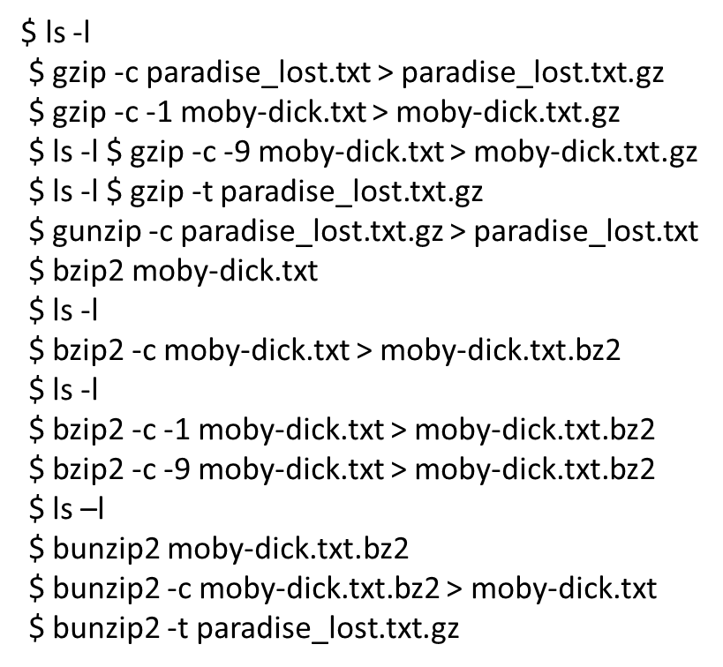

Slide 50




Archive with Tar Archive and Compress Files with tar and gzip -zcvf If you look back at "Archive and Compress Files Using gzip" and "Archive and Compress Files Using bzip2" and think about what was discussed there, you'll probably start to figure out a problem. What if you want to compress a directory that contains 100 files, contained in various subdirectories? If you use gzip or bzip2 with the -r (for recursive) option, you'll end up with 100 individually compressed files, each stored neatly in its original subdirectory. This is undoubtedly not what you want. How would you like to attach 100 .gz or .bz2 files to an email? Yikes! That's where tar comes in. First you'd use tar to archive the directory and its contents (those 100 files inside various subdirectories) and then you'd use gzip or bzip2 to compress the resulting tarball. Because gzip is the most common compression program used in concert with tar, we'll focus on

Slide 51


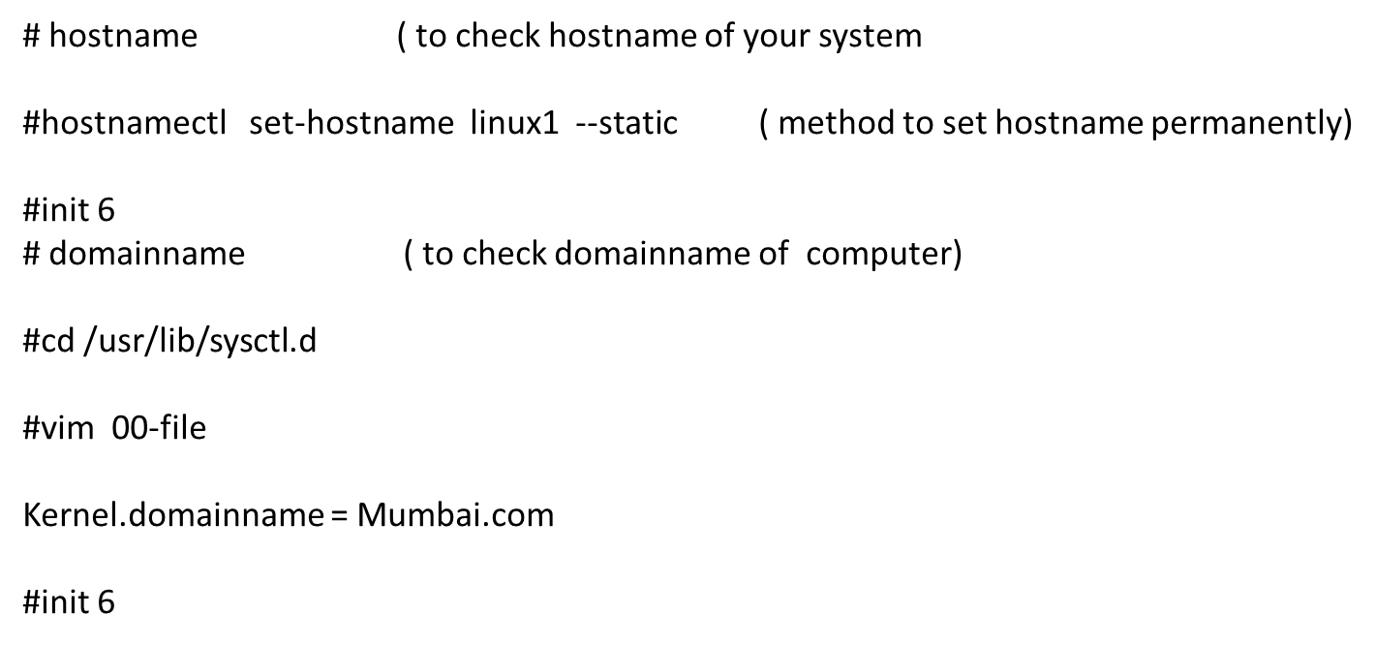

Slide 52


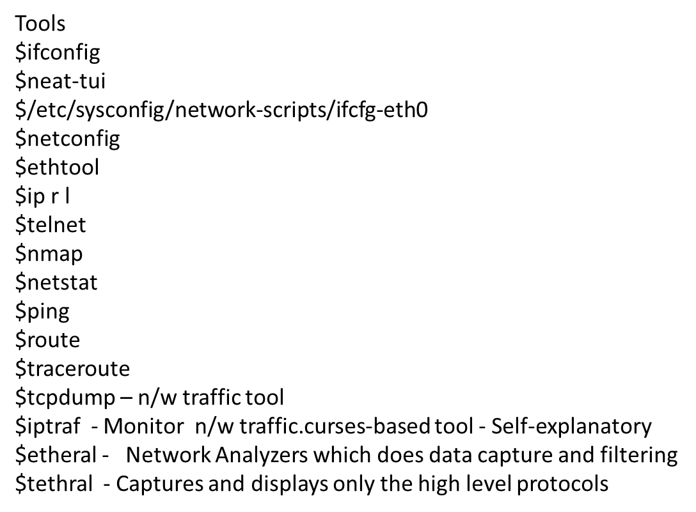

Slide 53


#ifconfig --> Status of all interfaces
eth0 Link encap:Ethernet HWaddr 00:50:FC:2A:2C:48
inet addr:192.0.34.7 Bcast:192.0.34.255 Mask:255.255.255.0
UP BROADCAST RUNNING MULTICAST MTU:1500 Metric:1
RX packets:0 errors:0 dropped:0 overruns:0 frame:0
TX packets:4 errors:0 dropped:0 overruns:0 carrier:0
collisions:0 txqueuelen:100
RX bytes:0 (0.0 b) TX bytes:240 (240.0 b)
Interrupt:11 Base address:0xf000
lo Link encap:Local Loopback
inet addr:127.0.0.1 Mask:255.0.0.0
UP LOOPBACK RUNNING MTU:16436 Metric:1
RX packets:1407 errors:0 dropped:0 overruns:0 frame:0
#nmtui [graphic method to assign ip]
#cd /etc/sysconfig/network-script [ editing Ethernet file ]
#ls
#vim ifcfg-enpos3 ( network file to set ip)
#nmcli con mod enp0s3 ipv4.addresses ‘192.168.1.4/24 192.168.1.1’

Slide 54


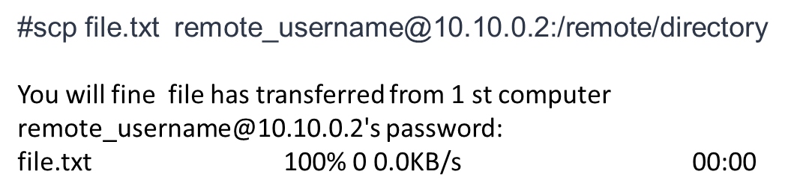
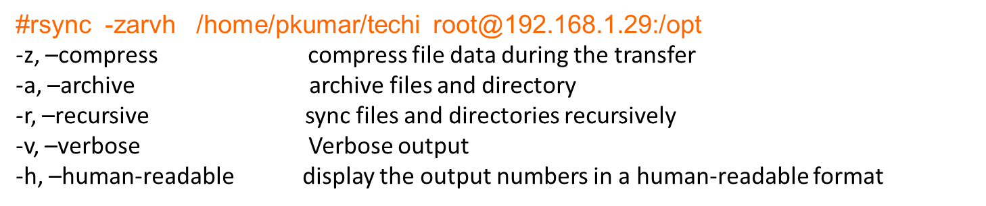
Rsync (Remote Sync) is a most commonly used command for copying and synchronizing files and directories remotely as well as locally in Linux/Unix systems. With the help of rsync command you can copy and synchronize your data remotely and locally across directories, across disks and networks, perform data backups and mirroring between two Linux machines.

Slide 55


Suppose we have hard disk /dev/sda we will create partition
_{#fdisk /dev/sda}
_{press m}
_{press n [for new partiotion]}
+10G [ we create partition of 10 GB ]
:p [ to check partition created or not]
:w [save & exit] & {[ to write it in partition table]
#fdisk -l [ to check partiotion table]
#cat /proc/partiotion [ to check the partiotion is in Ram , if
#partprobe [ now again check ]
so we have to format row file system with the help of any one of like ext3,ext4,xfs
#mkfs.ext4 /dev/sda11 ( file system assign)
#mkdir /oracle ( create mount point)
#mount /dev/sda11 /oracle ( To mount partion on mount point)
#df -h [ to check partition mounted or not ]
so to mount /oracle permanently we you fstab file
_{# vi /etc/fstab}
_{last line}
/dev/sda11 /oracle ext4 default 1 1
_{:wq !}
_{#mount -a}
#df -h [ now we can see /oracle is mounted even after rebooting system ]

Slide 56



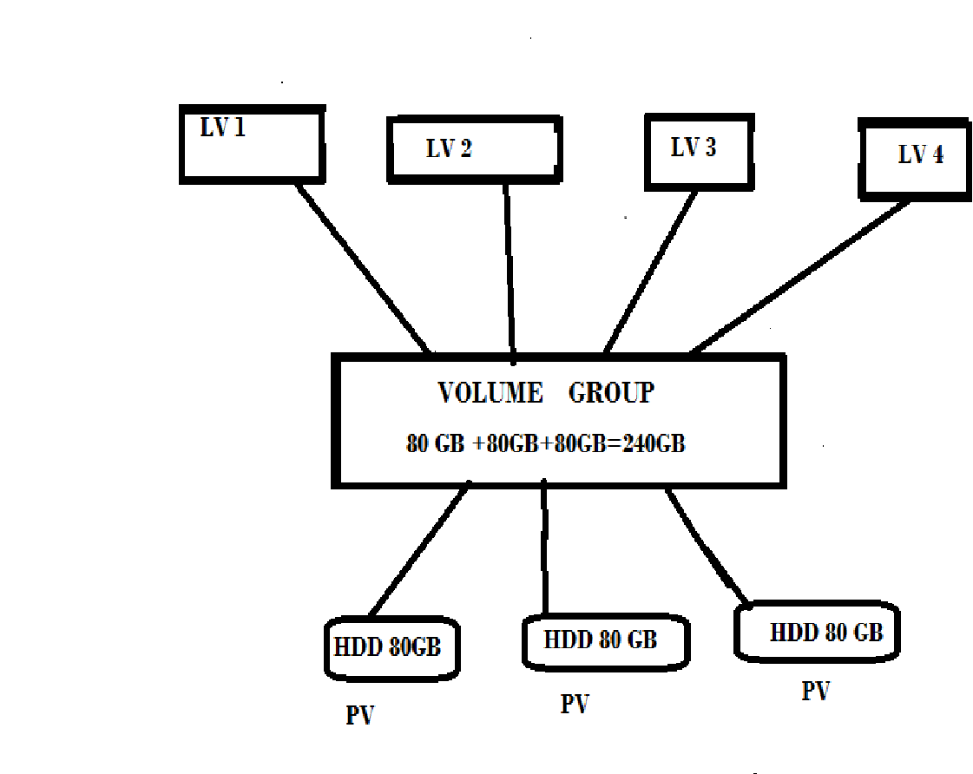
Logical volume management provides a higher−level view of the disk storage on a computer system than the traditional view of disks and partitions. This gives the system administrator much more flexibility in allocating storage to applications and users
LVM allows administrators to divide hard drive space into physical volumes (PV), which can then be combined into logical volume groups (VG), which are then divided into logical volumes (LV) on which the filesystem and mount point are created.
Physical volume (PV) :- PV are the partitions on hard disk, or hard disk itself. PV are the base of LVM structure and referred as physical volumes.
Volume Group (VG) :- VG are the combined physical volume into a single pool of storage. Think it is as a group of PV.
Logical volume (LV) :- LV are the actual partitions on system created from VG.

Slide 57

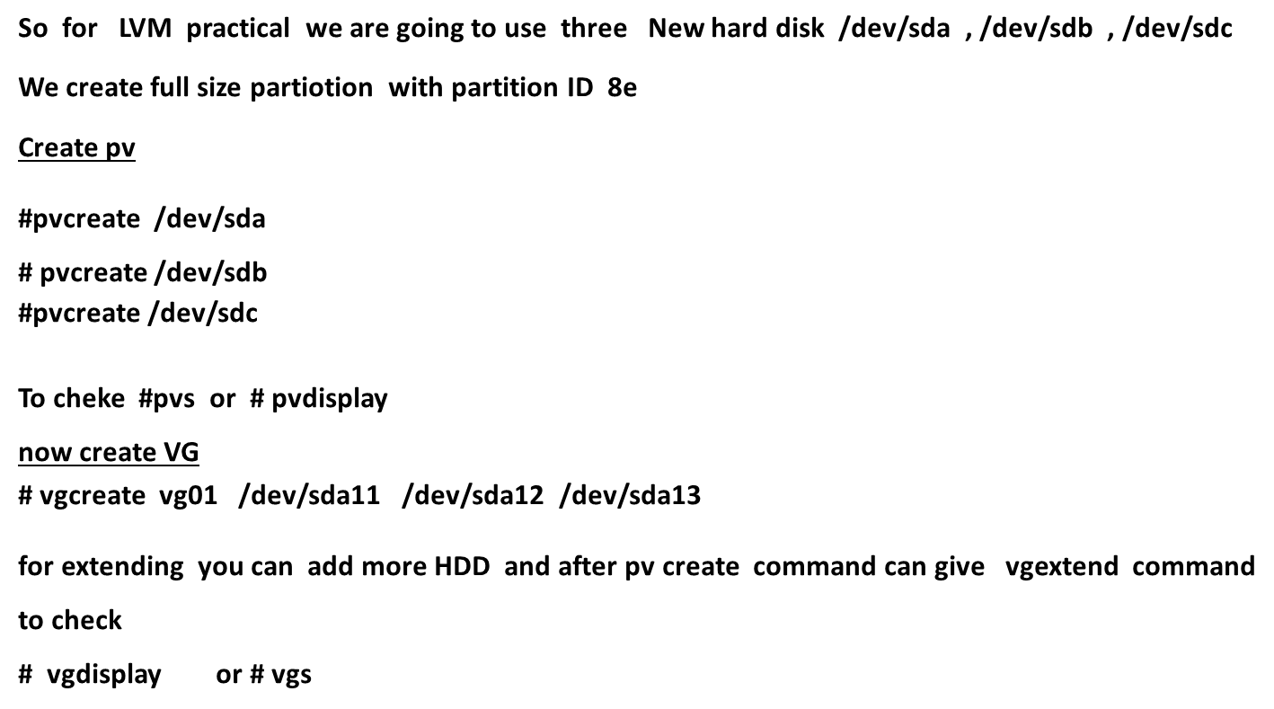

Slide 58


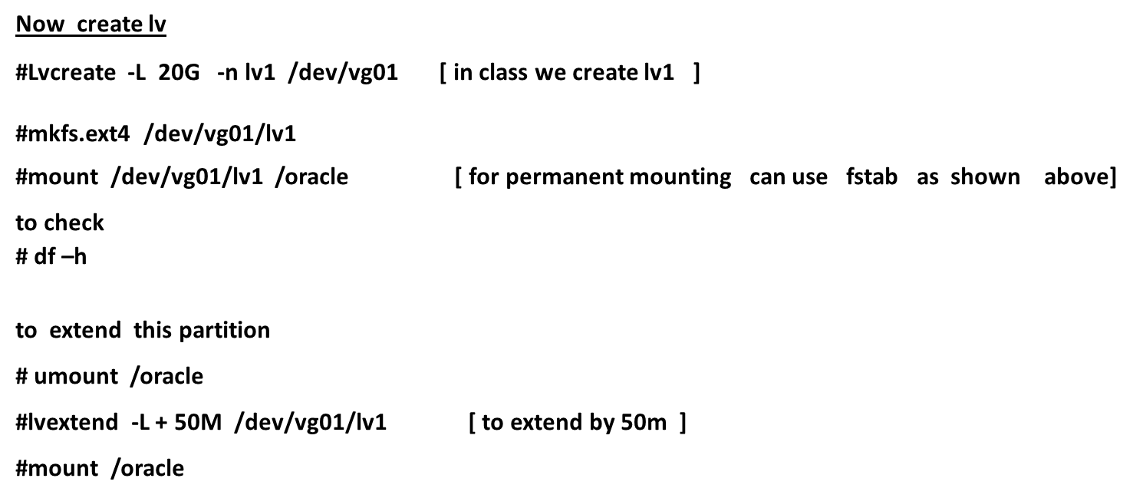

Slide 59


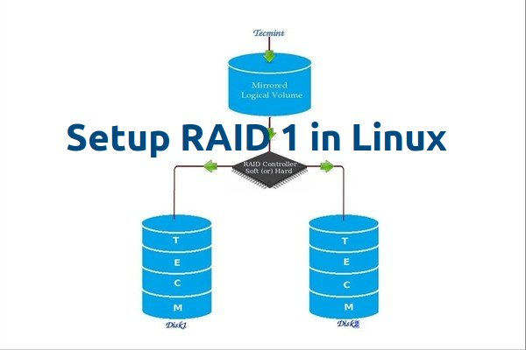
RAID Mirroring means an exact clone (or mirror) of the same data writing to two drives. A minimum two number of disks are more required in an array to create RAID1 and it’s useful only, when read performance or reliability is more precise than the data storage capacity.

Slide 60


Drive Partitioning for RAID
As I mentioned above, that we’re using minimum two partitions /dev/sdb and /dev/sdc for creating RAID1. Let’s create partitions on these two drives using ‘fdisk‘ command and change the type to raid during partition creation.
# fdisk /dev/sdb ( same way create the partion of other disk also /dev/sdc
Follow the below instructions
Press ‘n‘ for creating new partition.
Then choose ‘P‘ for Primary partition.
Next select the partition number as 1.
Give the default full size by just pressing two times Enter key.
Next press ‘p‘ to print the defined partition.
Press ‘L‘ to list all available types.
Type ‘t‘ to choose the partitions.
Choose ‘fd‘ for Linux raid auto and press Enter to apply.
Then again use ‘p‘ to print the changes what we have made.
Use ‘w‘ to write the changes.

Slide 61


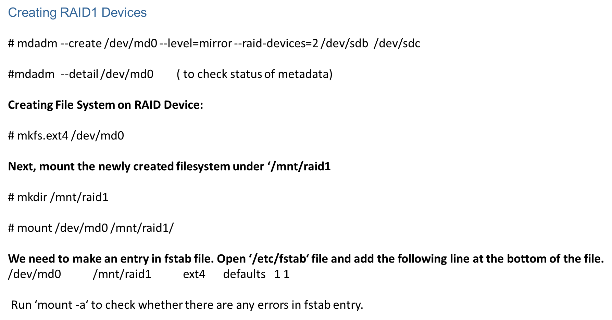

Slide 62


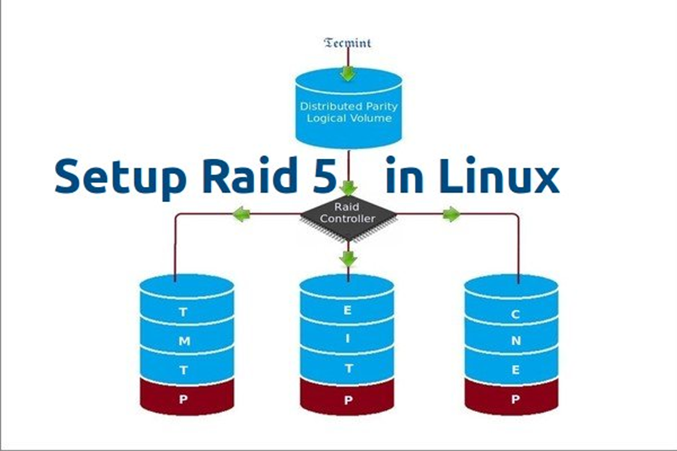
In RAID 5, data strips across multiple drives with distributed parity. The striping with distributed parity means it will split the parity information and stripe data over the multiple disks, which will have good data redundancy.

Slide 63


Partitioning the Disks for RAID
First and foremost, we have to partition the disks (/dev/sdb, /dev/sdc and /dev/sdd) before adding to a RAID, So let us define the partition using ‘fdisk’ command, before forwarding to the next steps.
# fdisk /dev/sdb
# fdisk /dev/sdc
# fdisk /dev/sdd
Create /dev/sdb Partition same way of /dev/sdc and /dev/sdd
Press ‘n‘ for creating new partition.
Then choose ‘P‘ for Primary partition. Here we are choosing Primary because there is no partitions defined yet.
Then choose ‘1‘ to be the first partition. By default it will be 1.
Here for cylinder size we don’t have to choose the specified size because we need the whole partition for RAID so just Press Enter two times to choose the default full size.
Next press ‘p‘ to print the created partition.
Change the Type, If we need to know the every available types Press ‘L‘.
Here, we are selecting ‘fd‘ as my type is RAID.
Next press ‘p‘ to print the defined partition.
Then again use ‘p‘ to print the changes what we have made.
Use ‘w‘ to write the changes.

Slide 64


Creating md device md0
# mdadm --create /dev/md0 --level=5 --raid-devices=3 /dev/sdb1 /dev/sdc1 /dev/sdd1
# mdadm --detail /dev/md0 ( TO check the status of meta device)
Creating file system for md0
# mkfs.ext4 /dev/md0
Now create a directory under ‘/mnt‘ then mount the created filesystem under /mnt/raid5 and check the files under mount point, you will see lost+found directory.
# mkdir /mnt/raid5
# mount /dev/md0 /mnt/raid5/
We need to add entry in fstab, else will not display our mount point after system reboot. To add an entry, we should edit the fstab file and append the following line as shown below. The mount point will differ according to your environment.
# vim /etc/fstab
/dev/md0 /mnt/raid5 ext4 defaults 1 1
Next, run ‘mount -av‘ command to check whether any errors in fstab entry.
# mount -a

Slide 65


Swap space is used in Linux when there is insufficient physical memory (RAM) on your system to store the data currently being processed. When your system needs more memory, inactive memory pages are written to the disk, freeing up physical memory. Swap space is located on disk drives, which have slower access times than physical memory. If your system is swapping often, you should add more physical memory, not more swap space.
Swap space in Linux is either a normal file in the file system, called a swap file, or a separate partition, or a combination of swap partitions and swap files.
#Fdisk -l ( to check the partition table)
Crate new partion with partition id 82
# fdisk /dev/sda
We have now created a partition of size 1000MB but we have not assigned it any partition type, so to assign a partition type, press “t” & press enter. partition id which for swap it’s 82
Next we will format our swap partition
#mkswap /dev/sda3
will then activate our newly created swap
#swapon /dev/sda3
. To mount it permanently we need to append /etc/fstab file
#vi /etc/fstab
/dev/sda3 swap swap default 0 0
#free -m ( to check swap size )

Slide 66


How Operating system passes through different stage of booting states.
Power on:
BIOS (Basic Input Output System) is a software program comes pre-built in a motherboard chipset.
BIOS loads and scans for devices such as Hard Disk, CD-ROM, RAM, etc.
BIOS searches for MBR (Master Boot Record: 1st sector) of the primary hard drive, it scans for 1st stage loader (In our case boot loader is (GRUB LILO) and hands over the responsibility to MBR.
Boot PROM/FLASH/BIOS is proficient of loading the MBR into RAM and executing it.
MBR (Master Boot Record):
512 bytes of space –> MBR
MBR contains the information of loader of most operating system e.g UNIX, Linux and WINDOWS
MBR holds the small binary information of 1st stage of loader
MBR consist physical sector of the first disk drive (i.e 512 bytes) and it’s not part of any partition.
Placed on the prime disk drive, in the prime sector of the first cylinder of track is 0 and head is 0 (this whole path is generally booked for boot programs)
MBR involve a mini executable programs and a table specify the primary partitions.

Slide 67


Boot Loader:
The boot loader termed from 1st stage loader and loads itself into RAM. All this go on in milliseconds.
The default stage 2 boot loader is a GRUB (Grand Unified Boot Loader) or LILO (Linux Loader)
Once GRUB is loaded into RAM, then it’s search for the location of Kernel.
GRUB will scrutinize the map file to find the kernel image, that is located under (/boot) and load it.
GRUB loads the kernel (vmlinuz-version) from /boot partition
Stage :1 GRUB organize RAMDISK for initrd —> (RAMDISK is reserved space from RAM). In addition, it drives initrd into RAM to ready the kernel for loading itself into memory and depended modules so that it can leave the system to “init” process
In, Linux most of the drivers are pre-built as modules, these would be initial ram drive (initrd.img) where it can keep all the information of additional modules. So, when the kernel boots, it creates ramdrive, loads the initrd.img and its depended modules.
Stage :2LILO needed to indicate MBR in order to locate operating systems on the hard drive. Any modifications done to /etc/lilo.conf, that must be updated in MBR, but in GRUB‘s case no need to update, it reads directly from the file /boot/grub/grub.conf.
After making changes in /etc/lilo.conf, we’ll have to update the MBR manually
Stage :3 The /initrd directory should not be removed it is a temporary place holder for kernel to have quick access to the modules that it needs to start the system modules include device drivers.

Slide 68



initialize CPU components, eg, MMU
initialize the scheduler (PID 0)
mount the root filesystem in rw mode
fork off the init process (PID 1)
In essence, kernel initialization does two things:
Start the core system of shared resource managers (RAM, processor and mass storage).
Starts a single process, /sbin/init.
Init process (sbin/init) is the very fist process which loads all the various daemons and mounts all the partitions which are listed under /etc/fstab.
The /sbin/init reads /etc/inittab file
Set default runlevel ( the telinit command allows administrators to tell the init process to change its current runlevel)
Calls /etc/rc.d/rc.sysinit and /etc/rc.d/rc x (where ‘x‘ is a runlevel)
In /etc/rc.d/rc5.d directory files starting with letter K –> kill scripts and files starting with letter S –> Startup scripts.
Start up the tty processes and xdm ( X display manager)
Starts User’s login screen

Slide 69


Power up / reboot:
The first step is to power up or reboot the system and edit the grub2 parameters. Timing here is critical. You must press ‘e’ before the menu times out and boots normally.
2. Linux16 Look for a line that mentions linux16 (or linuxefi if you are using UEFI bios). You may need to use the arrow keys to scroll down. At the end of the linux16 or linuxefi line, find and replace the rhgb quiet parameters with rd.break enforcing=0
3. Start boot process
Once you have edited the parameters accordingly, hit CTRL-X to start the boot process with the new parameters. The system should boot into the root system.
4. Remount as read/write
Enter the following command to remount the sysroot filesystem as read/write: #mount -o remount,rw /sysroot
5. chroot into sysroot
Now we chroot into the sysroot, using the following command: #chroot /sysroot
6. Change the password
We can use the passwd command to change the root password. # passwd root
7.This step is ommited you will not be able to login with your new root password. # touch /.autorelabel
8. The final step #exit

Slide 70


sudo‘ makes it possible to other system users to execute system commands without needing root password.
The sudoers file is a text file that lives at #/etc/sudoers
The sudo list looks like the below string, by default
root ALL= (ALL) ALL
For Granting sudo Access to other system users add that users name in that list below root
root ALL=(ALL) ALL
adam ALL=(ALL) ALL
tom ALL=(ALL) ALL
marks ALL=(ALL) ALL
For more control, you could add a line like the following, which would only permit the “alexander” user to run apt-get update.
alexander ALL=(ALL) /usr/bin/apt-get update
Put a “%” in front of the user, and it will define a group. The line below would allow every user in the group “admin” to have root-level permissions.
%admin ALL=(ALL) ALL
All this users will get all rights of root users without root password but for performing any task will have to use
Sudo word infront of command e.g.
(tom@linux1~)$ sudo useradd ram ( you can see tom also can create other system users )

Slide 71


RPM (Red Hat Package Manager) is an default open source and most popular package management utility for Red Hat based systems like (RHEL, CentOS and Fedora). The tool allows system administrators and users to install, update, uninstall, query, verify and manage system software packages in Unix/Linux operating systems. The RPM formerly known as .rpm file, that includes compiled software programs and libraries needed by the packages. This utility only works with packages that built on .rpm format.
With the help of these rpm command you can managed to install, update, remove packages in your Linux systems.
There are five basic modes for RPM command
Install : It is used to install any RPM package. e.g. # rpm –ivh vsftpd
Remove : It is used to erase, remove or un-install any RPM package. e.g. # rpm –e vsftpd
Upgrade : It is used to update the existing RPM package. e.g. # rpm -Uvh vsftpd
Verify : It is used to verify an RPM packages. e.g. # rpm -qc vsftpd
Query : It is used query any RPM package. e. g. # rpm -q vsftpd
It has some drawbacks therefore instead of rpm we use yum ( yellow dog update manager )
By rpm to update our system every time we have to mount and install CD/DVD of linux os
It never resolves dependencies ( dependent softwares )

Slide 72


YUM (Yellowdog Updater Modified) is an open source command-line as well as graphical based package management tool for RPM (RedHat Package Manager) based Linux systems. It allows users and system administrator to easily install, update, remove or search software packages on a systems. It was developed and released by Seth Vidal under GPL (General Public License) as an open source, means anyone can allowed to download and access the code to fix bugs and develop customized packages. YUM uses numerous third party repositories to install packages automatically by resolving their dependencies issues.
How to configure YUM
Insert cd /dvd of linux in drive
Mount # /dev/sro /mnt
Enter in #Cd /mnt
Copy packages in your system # cp -pr Packages /root ( it will take time 3.9 GB data will get copy in your system)
Go to the location #cd /etc/yum.repos.d
There create one file #vim local.repo
[localrepo]
name=localrepo
baseurl=file:///root/Packages
enable=1
gpgcheck=0
:wq!

Slide 73


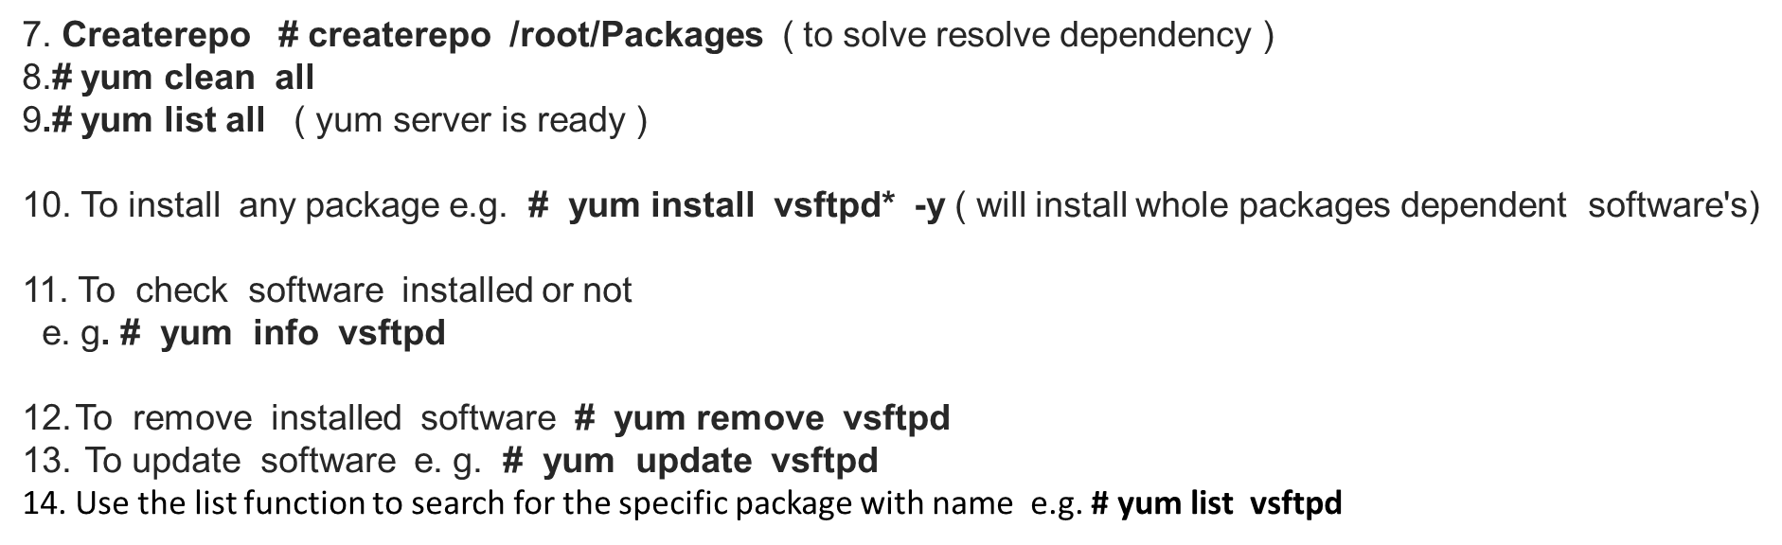

Slide 74


NFS (Network File System) is basically developed for sharing of files and folders between Linux/Unix systems by Sun Microsystems in 1980. It allows you to mount your local file systems over a network and remote hosts to interact with them as they are mounted locally on the same system
Benefits of NFS:
NFS allows local access to remote files.
With NFS it is not necessary that both machines run on the same OS
With the help of NFS we can configure centralized storage solutions
Users get their data irrespective of physical location
No manual refresh needed for new files
Can be secured with Firewalls and Kerberos.
Practical Tutorial:
We are using two servers : NFS Server: nfsserver.example.com with IP-192.168.0.100
NFS Client : nfsclient.example.com with IP-192.168.0.101
1.We need to install NFS packages on our NFS Server as well as on NFS Client machine.
[root@nfsserver ~]# yum install nfs-utils nfs*
2. Configure Export directory . For sharing a directory with NFS, we need to make an entry in “/etc/exports” configuration file
Here I’ll be creating a new directory named “nfsshare” in “/” partition to share with client server,

Slide 75

[root@nfsserver ~]# mkdir /nfsshare
3.Now we need to make an entry in “/etc/exports” and restart the services to make our directory shareable in the network.
[root@nfsserver ~]# vi /etc/exports
/nfsshare 192.168.0.101(rw,sync,no_root_squash)
NFS Options
ro: With the help of this option we can provide read only access to the shared files i.e client will only be able to read.
rw: This option allows the client server to both read and write access within the shared directory.
sync: Sync confirms requests to the shared directory only once the changes have been committed.
no_subtree_check: This option prevents the subtree checking. When a shared directory is the subdirectory of a larger file system, nfs performs scans of every directory above it, in order to verify its permissions and details. Disabling the subtree check may increase the reliability of NFS, but reduce security.
no_root_squash: This phrase allows root to connect to the designated directory.
4.To check export file [root@nfsserver ~]# exportfs -av
5. Start service [root@nfsserver~]# systemctl start nfs
#systemctl enable nfs-server.service
# systemctl start rpcbind

Slide 76


1.Now at the NFS client end, we need to mount that directory in our server to access it locally. To do so, first we need to find out that shares available on the remote server or NFS Server.
[root@nfsclient ~]# showmount -e 192.168.0.100
Export list for 192.168.0.100:
/nfsshare 192.168.0.101
Above command shows that a directory named “nfsshare” is available at “192.168.0.100” to share with your server.
Mount Shared NFS Directory
2.To mount that shared NFS directory we can use following mount command.
[root@nfsclient ~]# mount -t nfs 192.168.0.100:/nfsshare /mnt/nfsshare
The above command will mount that shared directory in “/mnt/nfsshare” on the client server.
3.The above mount command mounted the nfs shared directory on to nfs client temporarily, to mount an NFS directory permanently on your system across the reboots, we need to make an entry in “/etc/fstab“
[root@nfsclient ~]# vi /etc/fstab
Add the following new line as shown below.
192.168.0.100:/nfsshare /mnt nfs defaults 1 1

Slide 77


A daemon is a type of program on Unix-like operating systems that runs unobtrusively in the background, rather than under the direct control of a user, waiting to be activated by the occurance of a specific event or condition
Alternate terms for daemon are service.,started task
1.List all running units. # systemctl list-units.
2.List all failed units # systemctl –failed
3. Check if a Unit (cron.service) is enabled or not?. # systemctl is-enabled crond.service
4. Check whether a Unit or Service is running or not?. # systemctl status firewalld.service
5. . List all services (including enabled and disabled). # systemctl list-unit-files --type=service
How do I start, restart, stop, reload and check the status of a service (httpd.service) in Linux.
# systemctl start httpd.service
# systemctl restart httpd.service
# systemctl stop httpd.service
# systemctl reload httpd.service
# systemctl status httpd.service
7.How to active a service and enable or disable a service at boot time (auto start service at system boot).
# systemctl enable httpd.service
# systemctl disable httpd.service
8.How to a Kill a service using systemctl command.
# systemctl kill httpd
# systemctl status httpd

Slide 78


What is a Process?
A process has many components and properties
exec thread
PID priority
memory context
environment
file descriptors
security credentials
Display and update information about the top cpu processes
# top
THE DISPLAY
PID Every process runs have the process ID USER owner of the process
PRI Current priority of the process.
NICE Nice amount in the range -20 to 20, as established by the use of the command nice.
RES Resident memory: current amount of process memory that resides in physical memory, given in kilobytes.
STATE Current state (typically one of "sleep", "run", "idl", "zomb", or "stop").
TIME Number of system and user cpu seconds that the process has used.
SIZE Amount of memory the process needs
CPU Percentage of available cpu time used by this process.
COMMAND Name of the command that the process is currently running

Slide 79
Firewall in linux
A firewall is a way to protect machines from any unwanted traffic from outside. It enables users to control incoming network traffic on host machines by defining a set of firewall rules.
Firewall works in different zones
Block:Any incoming network connections are rejected with an icmp-host-prohibited message
Dmz:For computers in your demilitarized zone that are publicly-accessible with limited access
Drop:Any incoming network packets are dropped without any notification. Only outgoing network connections are possible.
External:For use on external networks
Home:For use at home when you mostly trust the other computers on the network. Only selected incoming connections are accepted.
Internal:Only selected incoming connections are accepted
Public:For use in public areas where you do not trust other computers on the network
Trusted:All network connections are accepted.
Work:For use at work where you mostly trust the other computers on the network. Only selected incoming connections are accepted.
[root@linux1~]#firewall-cmd --get-default-zone [to get current zone]
[root@linux1~]#firewall-cmd --set-default-zone --trusted [ to set new zone as you want]
[root@linux1~]#firewall-cmd --list-all-zones [you will get list of all above zone]
[root@linux1~]#firewall-cmd --list-all [to get details of services in current zone]
[root@linux1~]#firewall-cmd --add-service=http --permanent [Add the service]
[root@linux1~]#firewall-cmd –add-port=80/tcp --permanent [to add port]
[root@linux1~]#firewall-cmd --reload [to reload firewall]

Slide 80


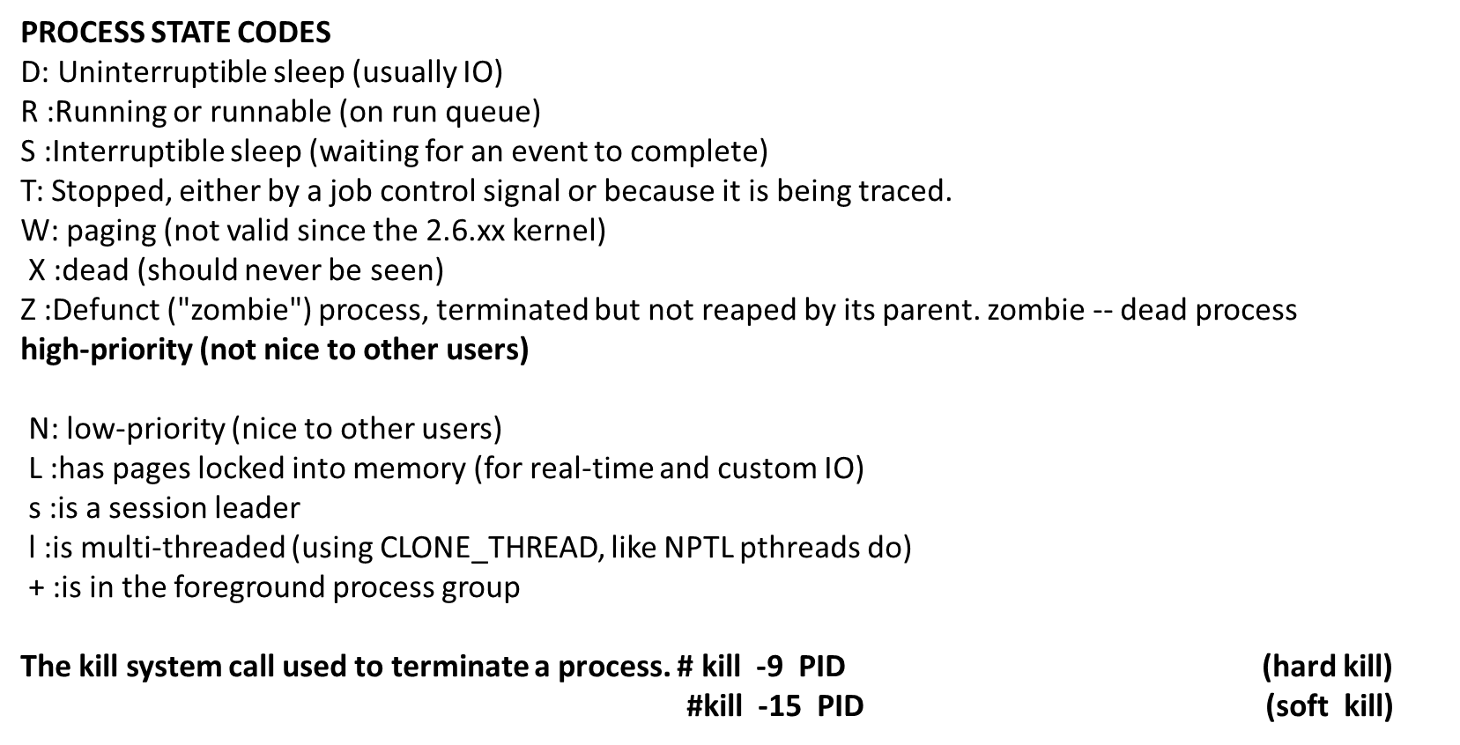

Slide 81


To schedule a task on given or later time you can use cron and anacron facilities in linux
Cron – is a daemon used to run scheduled tasks such as system backups, updates and many more. It is suitable for running scheduled tasks on machines that will run continuously 24X7 such as servers
Anacron is used to run commands periodically with a frequency defined in days. It works a little different from cron; assumes that a machine will not be powered on all the time or not run 24-7 such as laptops and desktops machines.
# vim /etc/crontab
* * * * * command to be executed
- - - - -
| | | | |
| | | | ----- Day of week (0 - 7) (Sunday=0 or 7)
| | | ------- Month (1 - 12)
| | --------- Day of month (1 - 31)
| ----------- Hour (0 - 23)
------------- Minute (0 - 59)

Slide 82


